Slide 1

Mini Project Presentation
LOSSY IMAGE COMPRESSION ENCODER BASED ON JPEG STANDARD
Amish Verma (2000910310033)
Mentor: Dr. Chhaya Dalela
DEPARTMENT OF ELECTRONICS & COMMUNICATION

Slide 2
Project Presentation Outline
Objective
Introduction
Why JPEG? And types of images
Lossy Compression
JPEG Compression Encoder
Chroma Subsampling
DCT and Quantization
Entropy Coding
Code Snippets
Results
References

Slide 3
Objective
This project focuses on implementing the JPEG compression encoder. The goal is to understand how processes such as chroma subsampling, DCT, quantization, and entropy encoding transforms pixel data, enabling efficient storage and transmission by balancing reduced file sizes with image quality.

Slide 4
Introduction
Image compression is crucial for reducing the data size of images. It makes images more manageable for storage and transmission.
In bandwidth-sensitive applications like web browsing, effective compression is indispensable.
This project implements the baseline JPEG compression encoder.
JPEG (Joint Photographic Experts Group) is a commonly used method of lossy compression for digital images, particularly for those images produced by digital photography.
JPEG typically achieves 10:1 compression with little perceptible loss in image quality.
Since its introduction in 1992, JPEG has been the most widely used image compression standard in the world.

Slide 5
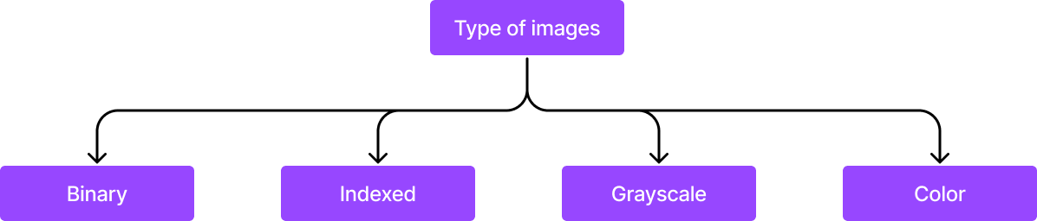
Why JPEG? And types of images
JPEG is chosen for its efficient balance between compression and image quality, making it ideal for applications with limited storage and bandwidth. It is a widely supported standard for photorealistic images.

Slide 6
Lossy Compression
Lossy compression is a type of data compression technique where some data is deliberately discarded in favor of reduced file size.
This discarding of data is based on some well-defined parameters and isn't random.
Lossy compression achieves much higher compression ratio than lossless compression due to obvious reasons.
While lossy compression uses many techniques such as quantization where we lose data, it must be noted that some stages of lossy compression techniques might also use lossless compression techniques (JPEG uses chroma subsampling, DCT, quantization, and Huffman coding).

Slide 7
JPEG Compression Encoder
The representation of the colors in the image is converted from RGB to YCbCr. Y is brightness (luminance) and Cb & Cr are colors (chroma).
The resolution of the chroma data is reduced, usually by a factor of 2 or 3 (chroma subsampling). This reflects the fact that the eye is less sensitive to fine color details than to fine brightness details.
The image is split into blocks of 8×8 pixels, and for each block, each of the Y, CB, and CR data undergoes the discrete cosine transform (DCT).
The amplitudes of the frequency components are quantized. Human vision is much more sensitive to small variations in color or brightness over large areas than to the strength of high-frequency brightness variations.
The resulting data for all 8×8 blocks is further compressed with a lossless algorithm, a variant of Huffman encoding.
The decoding process reverses these steps, except the quantization because it is irreversible.

Slide 8
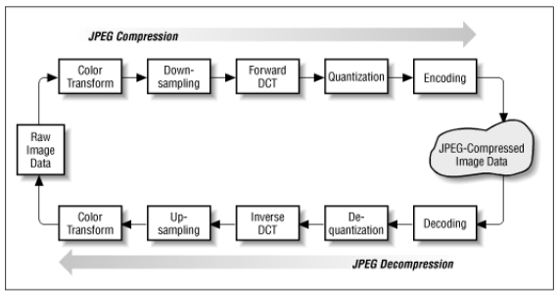
JPEG Compression Encoder
Source: https://uweb.engr.arizona.edu/~rlysecky/courses/ece576-07s/lectures/jpeg020606.pdf

Slide 9
Chroma Subsampling
Due to the densities of color- and brightness-sensitive receptors in the human eye, humans can see considerably more fine detail in the brightness of an image (the Y component) than in the hue and color saturation of an image (the Cb and Cr components). Using this knowledge, encoders can be designed to compress images more efficiently.
To reduce the spatial resolution of the Cb and Cr components is called downsampling or chroma subsampling.
The ratios at which the downsampling is ordinarily done for JPEG images are 4:4:4 (no downsampling), 4:2:2 (reduction by a factor of 2 in the horizontal direction), or (most commonly) 4:2:0 (reduction by a factor of 2 in both the horizontal and vertical directions).
We'll be using 4:2:0 chroma subsampling.

Slide 10
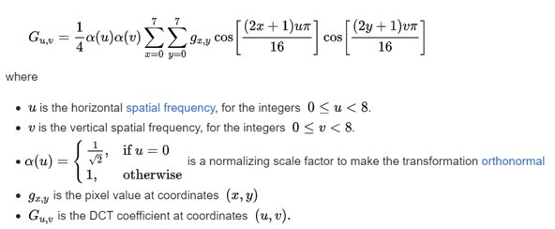
DCT and Quantization
After subsampling, each channel must be split into 8×8 blocks.
Next, each 8×8 block of each component (Y, Cb, Cr) is converted to a frequency-domain representation, using a normalized, two-dimensional type-II discrete cosine transform (DCT).
Before computing the DCT of the 8×8 block, its values are shifted from a positive range to one centered on zero. This step reduces the dynamic range requirements in the DCT processing stage that follows.
Next, we apply the two-dimensional DCT to each of the 8×8 blocks.
Source: https://en.wikipedia.org/wiki/JPEG#Discrete_cosine_transform

Slide 11
DCT and Quantization continued...
The human eye is good at seeing small differences in brightness over a relatively large area, but not so good at distinguishing the exact strength of a high frequency brightness variation. This allows one to greatly reduce the amount of information in the high frequency components.
This is done by simply dividing each component in the frequency domain by a constant for that component, and then rounding to the nearest integer.
This rounding operation is the only lossy operation in the whole process (other than chroma subsampling).
As a result of this, it is typically the case that many of the higher frequency components are rounded to zero, and many of the rest become small positive or negative numbers, which take many fewer bits to represent. The elements in the quantization matrix control the compression ratio, with larger values producing greater compression.

Slide 12
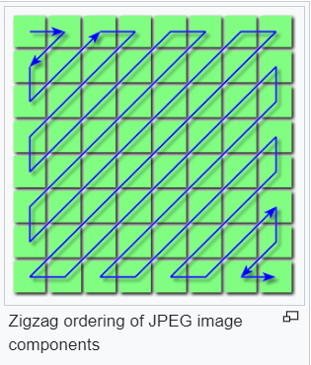
Entropy Coding
Entropy coding is a special form of lossless data compression.
It involves arranging the image components in a "zigzag" order employing run-length encoding (RLE) algorithm that groups similar frequencies together, inserting length coding zeros, and then using Huffman coding on what is left.
Use of Huffman coding is what's usually done instead of using the mathematically superior arithmetic coding.
Source: https://en.wikipedia.org/wiki/JPEG#/media/File:JPEG_ZigZag.svg

Slide 13
Code Snippets

Slide 14
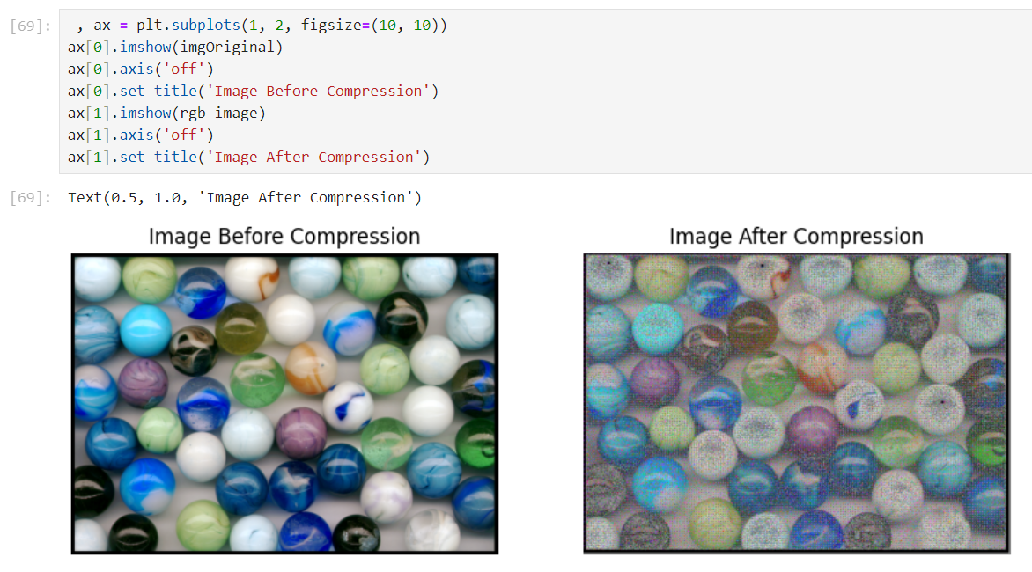
Results

Slide 15
References
[1] K. Sharma and K. Gupta, "Lossless data compression techniques and their performance," 2017 International Conference on Computing, Communication and Automation (ICCCA), Greater Noida, India, 2017, pp. 256-261, doi: 10.1109/CCAA.2017.8229810.
[2] G. K. Wallace, "The JPEG still picture compression standard," in IEEE Transactions on Consumer Electronics, vol. 38, no. 1, pp. xviii-xxxiv, Feb. 1992, doi: 10.1109/30.125072.
[3] G. Hudson, A. Léger, B. Niss and I. Sebestyén, "JPEG at 25: Still Going Strong," in IEEE MultiMedia, vol. 24, no. 2, pp. 96-103, Apr.-June 2017, doi: 10.1109/MMUL.2017.38.
[4] Image Types: https://www.mathworks.com/help/images/image-types-in-the-toolbox.html, Accessed on 01/12/23.
[5] Understanding and Decoding a JPEG Image using Python: https://yasoob.me/posts/understanding-and-writing-jpeg-decoder-in-python/, Accessed on 01/12/23.

Slide 16
Thank You

